Slide 1
Data Insight Analyst Interview
Jonathan Manton

Slide 2
What will we be covering?
What is our goal?
Understanding our Data
Areas to Focus on to Build Subscriber Growth
Conclusion

Slide 3
What is our goal?
For the History Extra website, use the data at hand to derive a strategy to grow subscriber numbers in the US

Slide 4
A quick overview of the data…

Slide 5
A quick overview of the data…
Our data is a subset from Google Analytics showing visits to the History Extra domain for the 1st – 3rd June 2019

Slide 6
A quick overview of the data…
Our data is a subset from Google Analytics showing visits to the History Extra domain for the 1st – 3rd June 2019
It contains a breakdown of visits to the History Extra domain and its sub-sites along with additional categorical data such as:

Slide 7
A quick overview of the data…
Our data is a subset from Google Analytics showing visits to the History Extra domain for the 1st – 3rd June 2019
It contains a breakdown of visits to the History Extra domain and its sub-sites along with additional categorical data such as:
The device type used to watch the site
The type of member they are
The referral site that bought them to the History Extra site
How many times that user has visited
The country the view occurred in
Notes:
e..g tablet or mobile phone
Subscriber, member or an anonymous user
Google, direct
US

Slide 8
What is our data telling us?
Notes:
UK – 22%, Australia 8%

Slide 9
What is our data telling us?
Lets have a look at the US user engagement…
Notes:
UK – 22%, Australia 8%

Slide 10
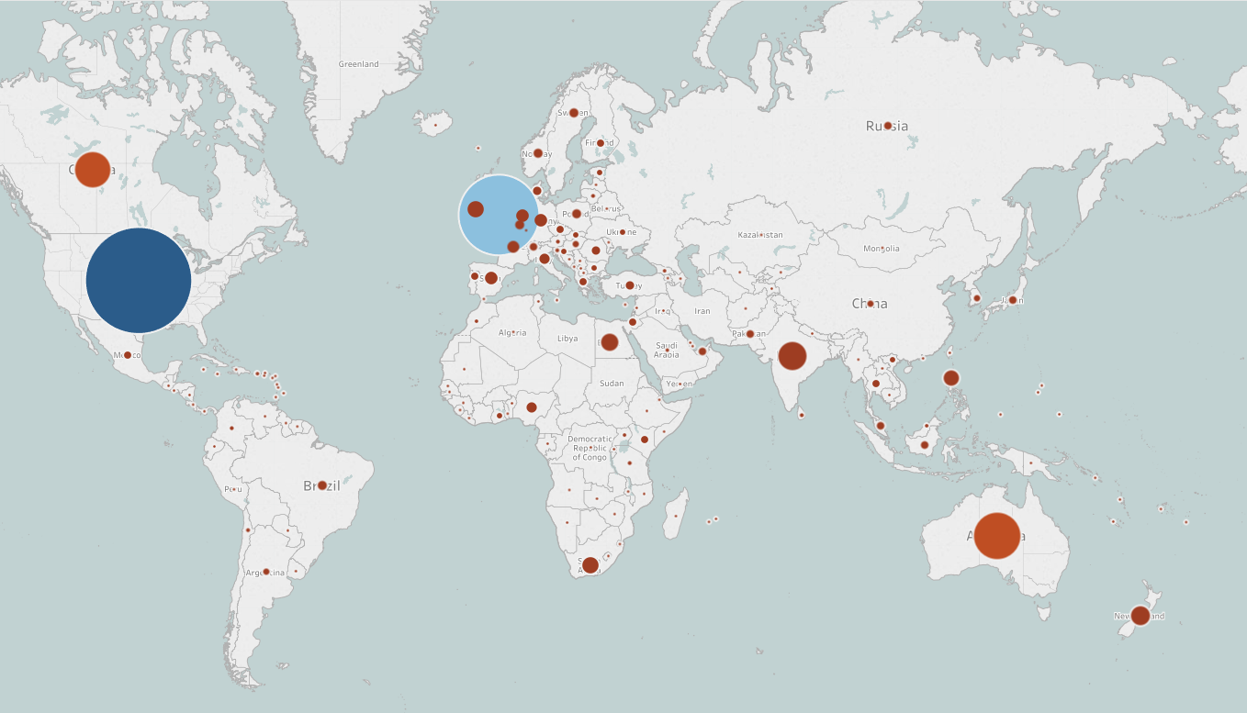
How does the US stack up globally?
Notes:
The size and colour of the bubble demonstrates visually the views for each country
UK – 22%, Australia 8% round up the top 3

Slide 11
How does the US stack up globally?
During the three days in question…
The US had the most amount of visits to the History Extra domain with 68,158
Notes:
The size and colour of the bubble demonstrates visually the views for each country
UK – 22%, Australia 8% round up the top 3

Slide 12
How does the US stack up globally?
During the three days in question…
The US had the most amount of visits to the History Extra domain with 68,158
That’s 40% of the global activity
Notes:
The size and colour of the bubble demonstrates visually the views for each country
UK – 22%, Australia 8% round up the top 3

Slide 13
How many users are visiting in the US?
Notes:
Of the top 25 countries, the US has 46% of total unique users

Slide 14
How many users are visiting in the US?
Those 68,158 views were from 40,351 unique users that visited the site
That is 41% of the global users
Notes:
Of the top 25 countries, the US has 46% of total unique users

Slide 15
How many users are visiting in the US?
Notes:
This validates the request, as it woul dbenefit to increase the subscribers in the largest market globally

Slide 16
How many users are visiting in the US?
Despite having the most amount of views and users, the US only has the 7th highest number of subscribers when looked at as a % of total users
Notes:
This validates the request, as it woul dbenefit to increase the subscribers in the largest market globally

Slide 17
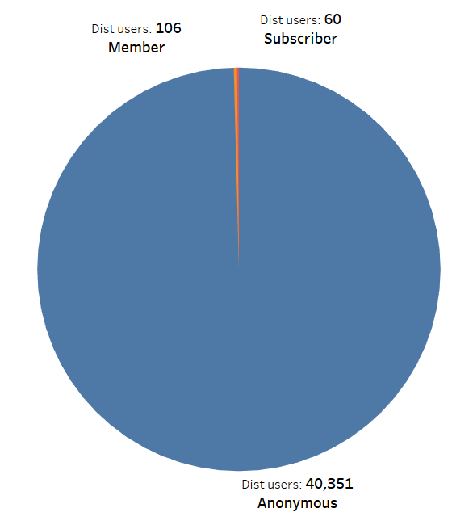
What is the member split in the US?
To the left we can see that, of the 40,351 users, that only 60 are subscribers (0.15%)
Notes:
The anonymous is the same as the total as at onstage, every user logged in as anonymous despite being a member or subscriber.

Slide 18
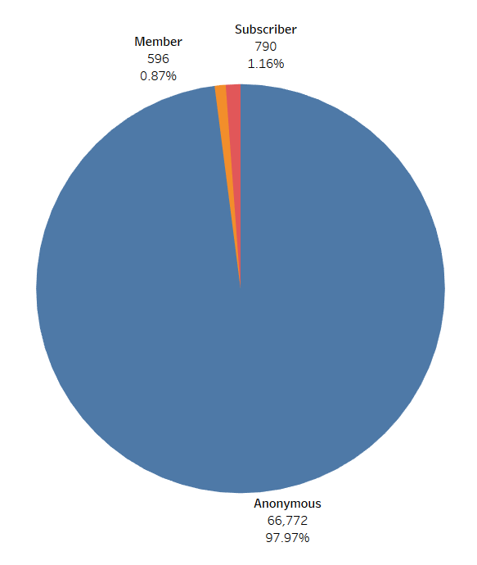
What % views do these groups account for?
To the left we can see that, of the 40,351 users, that only 60 are subscribers (0.15%)
When we look at the views per user type we see that the subscribers increase their % share to 1.16%
Notes:
UK – 22%, Australia 8%
THE VAST MAJORITY OF BOTH USERS AND VIEWS ARE FROM ANONYMOUS VISITORS

Slide 19
Which member group visits HE most?
When we analyse the subscriber data more, we can see that the average number of views for subscribers is 2.3 times higher than the members and 8 times higher than the anonymous users
Notes:
UK – 22%, Australia 8%

Slide 20
Which member group visits HE most?
When we analyse the subscriber data more, we can see that the average number of views for subscribers is 2.3 times higher than the members and 8 times higher than the anonymous users
This makes sense as the subscribers will be the users who enjoy this content the most
Notes:
UK – 22%, Australia 8%

Slide 21
Which member group visits HE most?
When we analyse the subscriber data more, we can see that the average number of views for subscribers is 2.3 times higher than the members and 8 times higher than the anonymous users
This makes sense as the subscribers will be the users who enjoy this content the most
This also demonstrates the need for increasing the subscriber count on History Extra
Notes:
UK – 22%, Australia 8%

Slide 22
What is our data telling us?
Now lets see how content is viewed and what US users enjoy…
Notes:
We have seen the US global share which, in terms of views and users looks very strong

Slide 23
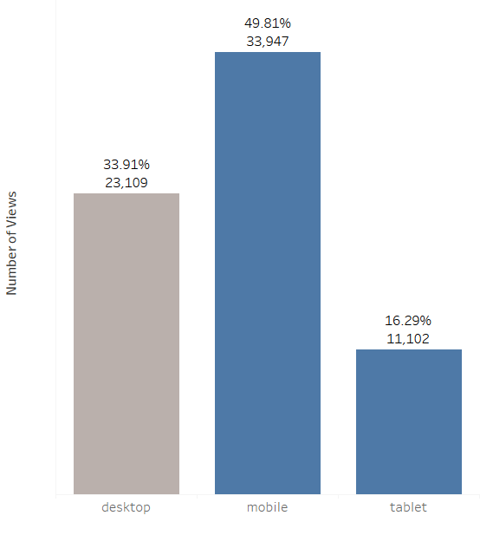
How is our content being watched?
A combined 66.1% of all views are done on a mobile platform
Notes:
Print is £10.99 per 3 issues
Print + Digital is £14.99 per 3 issues

Slide 24
How is our content being watched?
A combined 66.1% of all views are done on a mobile platform
This follows how data and content is being consumed in the world
Notes:
Print is £10.99 per 3 issues
Print + Digital is £14.99 per 3 issues

Slide 25
How is our content being watched?
A combined 66.1% of all views are done on a mobile platform
This follows how data and content is being consumed in the world
This is positive for the subscriber push as the online only price is £4 a month and so more easily sold to the customer
Notes:
Print is £10.99 per 3 issues
Print + Digital is £14.99 per 3 issues

Slide 26
What content are people watching?
Category | Views | % of Total Views | Running Total %
tudor | 16,612 | 27.51% | 27.51%
victorian | 7,306 | 12.10% | 39.60%
medieval | 6,494 | 10.75% | 50.36%
second-world-war | 5,561 | 9.21% | 59.56%
20th-century | 5,370 | 8.89% | 68.46%
elizabethan | 2,848 | 4.72% | 73.17%
georgian | 2,820 | 4.67% | 77.84%
roman | 2,003 | 3.32% | 81.16%
modern | 1,894 | 3.14% | 84.29%
stuart | 1,558 | 2.58% | 86.87%
viking | 1,320 | 2.19% | 89.06%
first-world-war | 1,147 | 1.90% | 90.96%
ancient-egypt | 1,110 | 1.84% | 92.80%
anglo-saxon | 586 | 0.97% | 93.77%
ancient-history | 463 | 0.77% | 94.53%
Notes:
We have categorised the web pages and can see the top 15 by views here
In 2016 UK had 2.8 million people visit from the US, of which an estimated 60% visited a royal venue like Buckingham Palace

Slide 27
What content are people watching?
Category | Views | % of Total Views | Running Total %
tudor | 16,612 | 27.51% | 27.51%
victorian | 7,306 | 12.10% | 39.60%
medieval | 6,494 | 10.75% | 50.36%
second-world-war | 5,561 | 9.21% | 59.56%
20th-century | 5,370 | 8.89% | 68.46%
elizabethan | 2,848 | 4.72% | 73.17%
georgian | 2,820 | 4.67% | 77.84%
roman | 2,003 | 3.32% | 81.16%
modern | 1,894 | 3.14% | 84.29%
stuart | 1,558 | 2.58% | 86.87%
viking | 1,320 | 2.19% | 89.06%
first-world-war | 1,147 | 1.90% | 90.96%
ancient-egypt | 1,110 | 1.84% | 92.80%
anglo-saxon | 586 | 0.97% | 93.77%
ancient-history | 463 | 0.77% | 94.53%
We can see that 5 of the top 15 popular topics relate to the British Royal family of past
Notes:
We have categorised the web pages and can see the top 15 by views here
In 2016 UK had 2.8 million people visit from the US, of which an estimated 60% visited a royal venue like Buckingham Palace

Slide 28
What content are people watching?
Category | Views | % of Total Views | Running Total %
tudor | 16,612 | 27.51% | 27.51%
victorian | 7,306 | 12.10% | 39.60%
medieval | 6,494 | 10.75% | 50.36%
second-world-war | 5,561 | 9.21% | 59.56%
20th-century | 5,370 | 8.89% | 68.46%
elizabethan | 2,848 | 4.72% | 73.17%
georgian | 2,820 | 4.67% | 77.84%
roman | 2,003 | 3.32% | 81.16%
modern | 1,894 | 3.14% | 84.29%
stuart | 1,558 | 2.58% | 86.87%
viking | 1,320 | 2.19% | 89.06%
first-world-war | 1,147 | 1.90% | 90.96%
ancient-egypt | 1,110 | 1.84% | 92.80%
anglo-saxon | 586 | 0.97% | 93.77%
ancient-history | 463 | 0.77% | 94.53%
We can see that 5 of the top 15 popular topics relate to the British Royal family of past
We can also see both world wars on this list, perhaps these views are remaining from the centenary anniversary of the end of WW1
Notes:
We have categorised the web pages and can see the top 15 by views here
In 2016 UK had 2.8 million people visit from the US, of which an estimated 60% visited a royal venue like Buckingham Palace

Slide 29
What content are people watching?
Page Title | Views | % of Total
‘The Spanish Princess’: The Real History You Need to Know - History Extra | 6,368 | 9.34%
Elizabeth I: everything you need to know about the 'Virgin Queen’, daughter of Anne Boleyn and Henry VIII - History Extra | 1,403 | 2.06%
Anne Boleyn: 11 Surprising Facts - History Extra | 1,399 | 2.05%
Queen Victoria's Sons And Daughters: Who Were They? - History Extra | 1,309 | 1.92%
BBC History Magazine & BBC World Histories Magazine - History Extra | 1,164 | 1.71%
10 Facts About Bonnie Prince Charlie and the Jacobites - History Extra | 1,157 | 1.70%
Who are the women from history who changed the world? - History Extra | 1,070 | 1.57%
Catherine of Aragon's Marriages To Prince Arthur and King Henry VIII - History Extra | 1,062 | 1.56%
Queen Victoria’s children: How many children did Queen Victoria and Prince Albert have? What was Victoria like as a mother? Did she hate being pregnant? - History Extra | 989 | 1.45%
Queen Elizabeth and Prince Philip's Relationship and Marriage: 8 Facts - History Extra | 878 | 1.29%
From Pageantry to Controversy: a Brief History of State Visits - History Extra | 790 | 1.16%
WW2: Was The US Right To Drop Atomic Bombs On Hiroshima And Nagasaki? You Debate - History Extra | 717 | 1.05%
8 facts about Princess Margaret, the Queen's younger sister: was she really a rebel princess? - History Extra | 645 | 0.95%
Victoria at 200: 7 Surprising Facts About Queen Victoria - History Extra | 634 | 0.93%
12 surprising facts about Queen Elizabeth II: When did she become queen? How many corgis does she have? Who are her children? - History Extra | 617 | 0.91%
Was Catherine of Aragon a Virgin When She Married Henry VIII? - History Extra | 613 | 0.90%
A brief history of the Vikings: facts about who they were and where they came from - History Extra | 598 | 0.88%
Katherine of Aragon and the Lost Heirs of Henry VIII - History Extra | 598 | 0.88%
The 1897 Battle of Saragarhi: The Real History Behind Kesari - History Extra | 592 | 0.87%
The Black Death: 10 Surprising Facts - History Extra | 588 | 0.86%
Anne of Cleves: Henry VIII's Most Successful Queen? - History Extra | 544 | 0.80%
The Most Significant Battles of WW2 - History Extra | 476 | 0.70%
D-Day on Screen: 5 of the Best Films and TV Series - History Extra | 463 | 0.68%
In Bed with the Romans: A Brief History of Sex in Ancient Rome - History Extra | 463 | 0.68%
Unlock The Library - History Extra | 439 | 0.64%
Notes:
The Spanish Princess is a newly started TV show on Stars in the US, hence the 10% share in views. Also The Favourite
The American public are fascinated with the UK royal family, weddings, births and more

Slide 30
What content are people watching?
Page Title | Views | % of Total
‘The Spanish Princess’: The Real History You Need to Know - History Extra | 6,368 | 9.34%
Elizabeth I: everything you need to know about the 'Virgin Queen’, daughter of Anne Boleyn and Henry VIII - History Extra | 1,403 | 2.06%
Anne Boleyn: 11 Surprising Facts - History Extra | 1,399 | 2.05%
Queen Victoria's Sons And Daughters: Who Were They? - History Extra | 1,309 | 1.92%
BBC History Magazine & BBC World Histories Magazine - History Extra | 1,164 | 1.71%
10 Facts About Bonnie Prince Charlie and the Jacobites - History Extra | 1,157 | 1.70%
Who are the women from history who changed the world? - History Extra | 1,070 | 1.57%
Catherine of Aragon's Marriages To Prince Arthur and King Henry VIII - History Extra | 1,062 | 1.56%
Queen Victoria’s children: How many children did Queen Victoria and Prince Albert have? What was Victoria like as a mother? Did she hate being pregnant? - History Extra | 989 | 1.45%
Queen Elizabeth and Prince Philip's Relationship and Marriage: 8 Facts - History Extra | 878 | 1.29%
From Pageantry to Controversy: a Brief History of State Visits - History Extra | 790 | 1.16%
WW2: Was The US Right To Drop Atomic Bombs On Hiroshima And Nagasaki? You Debate - History Extra | 717 | 1.05%
8 facts about Princess Margaret, the Queen's younger sister: was she really a rebel princess? - History Extra | 645 | 0.95%
Victoria at 200: 7 Surprising Facts About Queen Victoria - History Extra | 634 | 0.93%
12 surprising facts about Queen Elizabeth II: When did she become queen? How many corgis does she have? Who are her children? - History Extra | 617 | 0.91%
Was Catherine of Aragon a Virgin When She Married Henry VIII? - History Extra | 613 | 0.90%
A brief history of the Vikings: facts about who they were and where they came from - History Extra | 598 | 0.88%
Katherine of Aragon and the Lost Heirs of Henry VIII - History Extra | 598 | 0.88%
The 1897 Battle of Saragarhi: The Real History Behind Kesari - History Extra | 592 | 0.87%
The Black Death: 10 Surprising Facts - History Extra | 588 | 0.86%
Anne of Cleves: Henry VIII's Most Successful Queen? - History Extra | 544 | 0.80%
The Most Significant Battles of WW2 - History Extra | 476 | 0.70%
D-Day on Screen: 5 of the Best Films and TV Series - History Extra | 463 | 0.68%
In Bed with the Romans: A Brief History of Sex in Ancient Rome - History Extra | 463 | 0.68%
Unlock The Library - History Extra | 439 | 0.64%
When we look at the content that is bringing in the most views, we can see that, of the top 10 most popular sites, 8 are related to the British Royals
Notes:
The Spanish Princess is a newly started TV show on Stars in the US, hence the 10% share in views. Also The Favourite
The American public are fascinated with the UK royal family, weddings, births and more

Slide 31
What are the areas to focus on?
Notes:
Lets focus first on content as subscribers will only be gained if the content is enjoyed.
Then lets get more information on the users of the website
Then use that to bring in more subscribers

Slide 32
What are the areas to focus on?
Content
Notes:
Lets focus first on content as subscribers will only be gained if the content is enjoyed.
Then lets get more information on the users of the website
Then use that to bring in more subscribers

Slide 33
What are the areas to focus on?
Content
Developing the Dataset
Notes:
Lets focus first on content as subscribers will only be gained if the content is enjoyed.
Then lets get more information on the users of the website
Then use that to bring in more subscribers

Slide 34
What are the areas to focus on?
Content
Developing the Dataset
High Traffic Anonymous Users
Notes:
Lets focus first on content as subscribers will only be gained if the content is enjoyed.
Then lets get more information on the users of the website
Then use that to bring in more subscribers

Slide 35
What are the areas to focus on?
Developing Content to Follow TV / Cinema Trends

Slide 36
Developing Content to Follow TV / Cinema
The top searches seen earlier in this presentation are very much related to TV and cinema. For example we will take the top 10:
Page Title | Related TV Show / Movie
‘The Spanish Princess’: The Real History You Need to Know - History Extra | The Spanish Princess
Elizabeth I: everything you need to know about the 'Virgin Queen’, daughter of Anne Boleyn and Henry VIII - History Extra | The Crown
Anne Boleyn: 11 Surprising Facts - History Extra | The Spanish Princess
Queen Victoria's Sons And Daughters: Who Were They? - History Extra | The Crown
BBC History Magazine & BBC World Histories Magazine - History Extra
10 Facts About Bonnie Prince Charlie and the Jacobites - History Extra | Outlander
Who are the women from history who changed the world? - History Extra | Trending topic in film / TV
Catherine of Aragon's Marriages To Prince Arthur and King Henry VIII - History Extra | The Spanish Princess
Queen Victoria’s children: How many children did Queen Victoria and Prince Albert have? What was Victoria like as a mother? | The Crown
Queen Elizabeth and Prince Philip's Relationship and Marriage: 8 Facts - History Extra
Notes:
Lets focus first on content as subscribers will only be gained if the content is enjoyed.
These ten sites account for 25% of the US views in the period in question so following on from TV/Cinema pays off

Slide 37
Developing Content to Follow TV / Cinema
Below are a small list of what historical programmes and films are releasing in 2020, these could be used to create content to further the enjoyment of users of these topics:
Victoria S3
Catherine the Great
The Aftermath
Vikings S6

Slide 38
Developing Content to Follow TV / Cinema
Below are a small list of what historical programmes and films are releasing in 2020, these could be used to create content to further the enjoyment of users of these topics:
Victoria S3
Catherine the Great
The Aftermath
Vikings S6
Mulan film
Downton Abbey Movie
Midway film
Robert the Bruce TV Show

Slide 39
Developing Content to Follow TV / Cinema
Below are a small list of what historical programmes and films are releasing in 2020, these could be used to create content to further the enjoyment of users of these topics:
Victoria S3
Catherine the Great
The Aftermath
Vikings S6
Mulan film
Downton Abbey Movie
Midway film
Robert the Bruce TV Show
Frontier Netflix
The Final Kingdom Netflix
Knightfall S2
The Crown S3

Slide 40
Developing Content to Follow TV / Cinema
What is the proposal?
Create content, alongside normal content, that mirrors the historical TV programs and films being released throughout the year
Notes:
Downton Abbey movie
Call The Midwife S8
Poldark S5
Victoria S3
Project Blue Book - UFO
Sanditon – Jane Austin Novel
Catherine the Great
The Crown S3 – Elizabeth II
The Spanish Princess – Catherine of Aragon
The Aftermath – WW2

Slide 41
Developing Content to Follow TV / Cinema
What is the proposal?
Create content, alongside normal content, that mirrors the historical TV programs and films being released throughout the year
In order to measure how this does we can set up an event on the newly made ‘Trend’ content pages and then a separate event on the ‘Non Trend’. We can then set the same goal for each on GA and then track the progress in terms of views going forward to identify trends
Notes:
Downton Abbey movie
Call The Midwife S8
Poldark S5
Victoria S3
Project Blue Book - UFO
Sanditon – Jane Austin Novel
Catherine the Great
The Crown S3 – Elizabeth II
The Spanish Princess – Catherine of Aragon
The Aftermath – WW2

Slide 42
What are the areas to focus on?
Capturing the behaviour of the anonymous visitors

Slide 43
Capturing the behaviour of the anonymous visitors
In order to try convert the anonymous users to subscribers we need to gather data into the overall behaviour of those anonymous users. The kinds of questions that would be beneficial would include:
Notes:
After we have looked at the content we now need to get a better understanding of the behaviour of the anonymous users

Slide 44
Capturing the behaviour of the anonymous visitors
In order to try convert the anonymous users to subscribers we need to gather data into the overall behaviour of those anonymous users. The kinds of questions that would be beneficial would include:
How many times was the subscription button pressed and not followed through?
Is there any demographic data around the anonymous users?
Notes:
After we have looked at the content we now need to get a better understanding of the behaviour of the anonymous users

Slide 45
Capturing the behaviour of the anonymous visitors
In order to try convert the anonymous users to subscribers we need to gather data into the overall behaviour of those anonymous users. The kinds of questions that would be beneficial would include:
How many times was the subscription button pressed and not followed through?
Is there any demographic data around the anonymous users?
The extra data surrounding the behaviour of the anonymous would allow us to analyse further into the behaviour and intentions of users. This greater understanding will help create a focused strategy to convert anonymous to Subscribers
Notes:
After we have looked at the content we now need to get a better understanding of the behaviour of the anonymous users

Slide 46
Capturing the behaviour of the anonymous visitors
Lets run through each of the two questions proposed:
Is there any demographic data around the anonymous users?
Proposal:
Utilising the reports we see in GA Demographics section we can use this info to see:
If the demographics of the anonymous visitors matches what the expected demographic is for our site is, if so we can target them for subscriptions
We could take this a bit further and go down to demographic vs expected demographic for the type of content viewed
Knowing the demographics can also allow us to target the right subset of people for subscriptions mailing lists or Google Ad campaigns etc.

Slide 47
Capturing the behaviour of the anonymous visitors
Lets run through each of the two questions proposed:
Is there any demographic data around the anonymous users?
Proposal:
Utilising the reports we see in GA Demographics section we can use this info to see:
If the demographics of the anonymous visitors matches what the expected demographic is for our site is, if so we can target them for subscriptions
We could take this a bit further and go down to demographic vs expected demographic for the type of content viewed
Knowing the demographics can also allow us to target the right subset of people for subscriptions mailing lists or Google Ad campaigns etc.

Slide 48
Capturing the behaviour of the anonymous visitors
How many times was the subscription button pressed and not followed through?
Notes:
We see from the webpages that the subscription page was visited 194 times, however we do not know how many times it was completed

Slide 49
Capturing the behaviour of the anonymous visitors
How many times was the subscription button pressed and not followed through?
Proposal:
Create an event on the page after the subscription button is pressed and also on the page where the sign up is complete. We then create goals for both to monitor the data. From this we can track and see:
The interest levels of anonymous users
We can also target the users which contemplated subscribing on mailing lists with special offers or even incentivised questionnaires to find out the reasons for not subscribing
Notes:
We see from the webpages that the subscription page was visited 194 times, however we do not know how many times it was completed

Slide 50
What are the areas to focus on?
Converting the high visit instance anonymous to subscribers

Slide 51
Converting high visit instance anonymous to subscribers
We have around 1,979 visits to History Extra from 531 unique users who have visited the site over 20 times however are not subscribed

Slide 52
Converting high visit instance anonymous to subscribers
We have around 1,979 visits to History Extra from 531 unique users who have visited the site over 20 times however are not subscribed
If these regular visitors could be converted to subscriptions that would be $25,500 per annum in sub fees

Slide 53
Converting high visit instance anonymous to subscribers
Proposal:
Identifying these users will allow us to create marketing campaign lists to tempt the regular user to subscribing
This campaign could contain a special offer such of first 6 months half price etc.
Notes:
Offering special offers or allow for questionnaires to be sent to fins out why

Slide 54
Lets recap our proposed strategy…
Utilise the current TV and Film trends to create content to piggyback off these successes

Slide 55
Lets recap our proposed strategy…
Utilise the current TV and Film trends to create content to piggyback off these successes
Gather and analyse further data surrounding the anonymous visitors behaviour to create focused a strategy

Slide 56
Lets recap our proposed strategy…
Utilise the current TV and Film trends to create content to piggyback off these successes
Gather and analyse further data surrounding the anonymous visitors behaviour to create focused a strategy
Put a focus on converting the regular anonymous visitors into subscribers

Slide 57
Thank you for listening

Slide 58
Any questions?

